Slide 1
Conflict Resolution

Slide 2
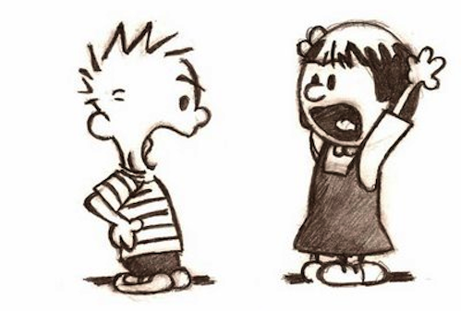
What is conflict???

Slide 3
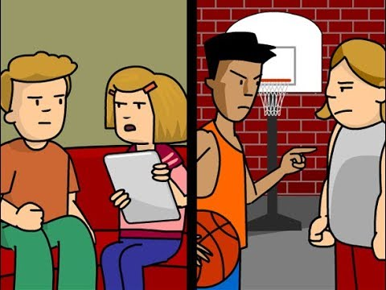

Slide 4
activity

Slide 5
REflection

Slide 6
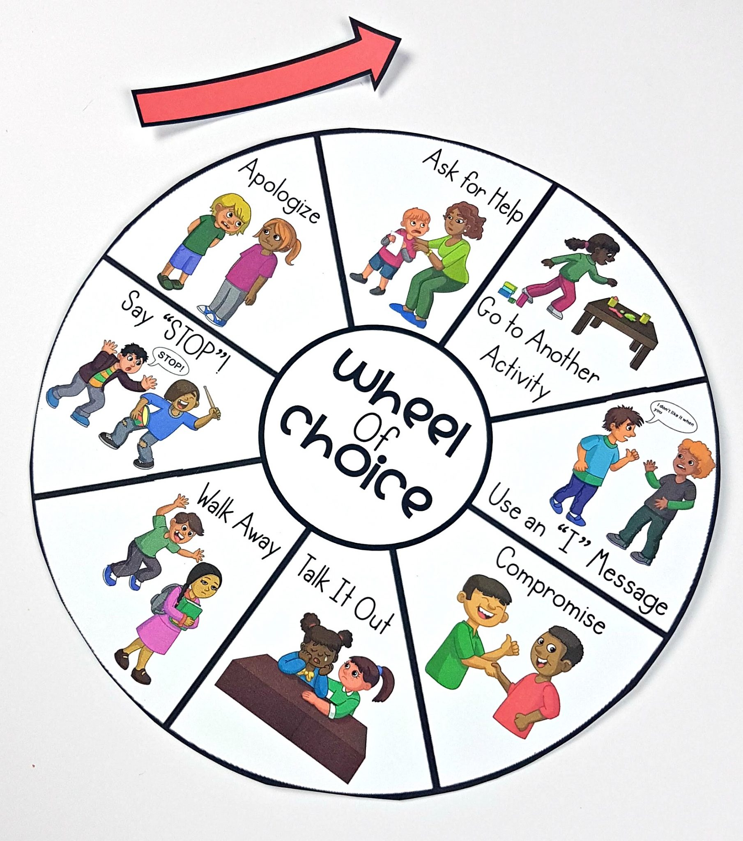

Slide 7
FINITO

